Slide 1

Lunchtime Learners
October 2023
Ben Salisbury, Customer Success

Slide 2

October 2023 Highlights
Expenses (People+)
Mileage (People+)
Notifications
New Functionality
💡 What should we cover next?

Slide 3

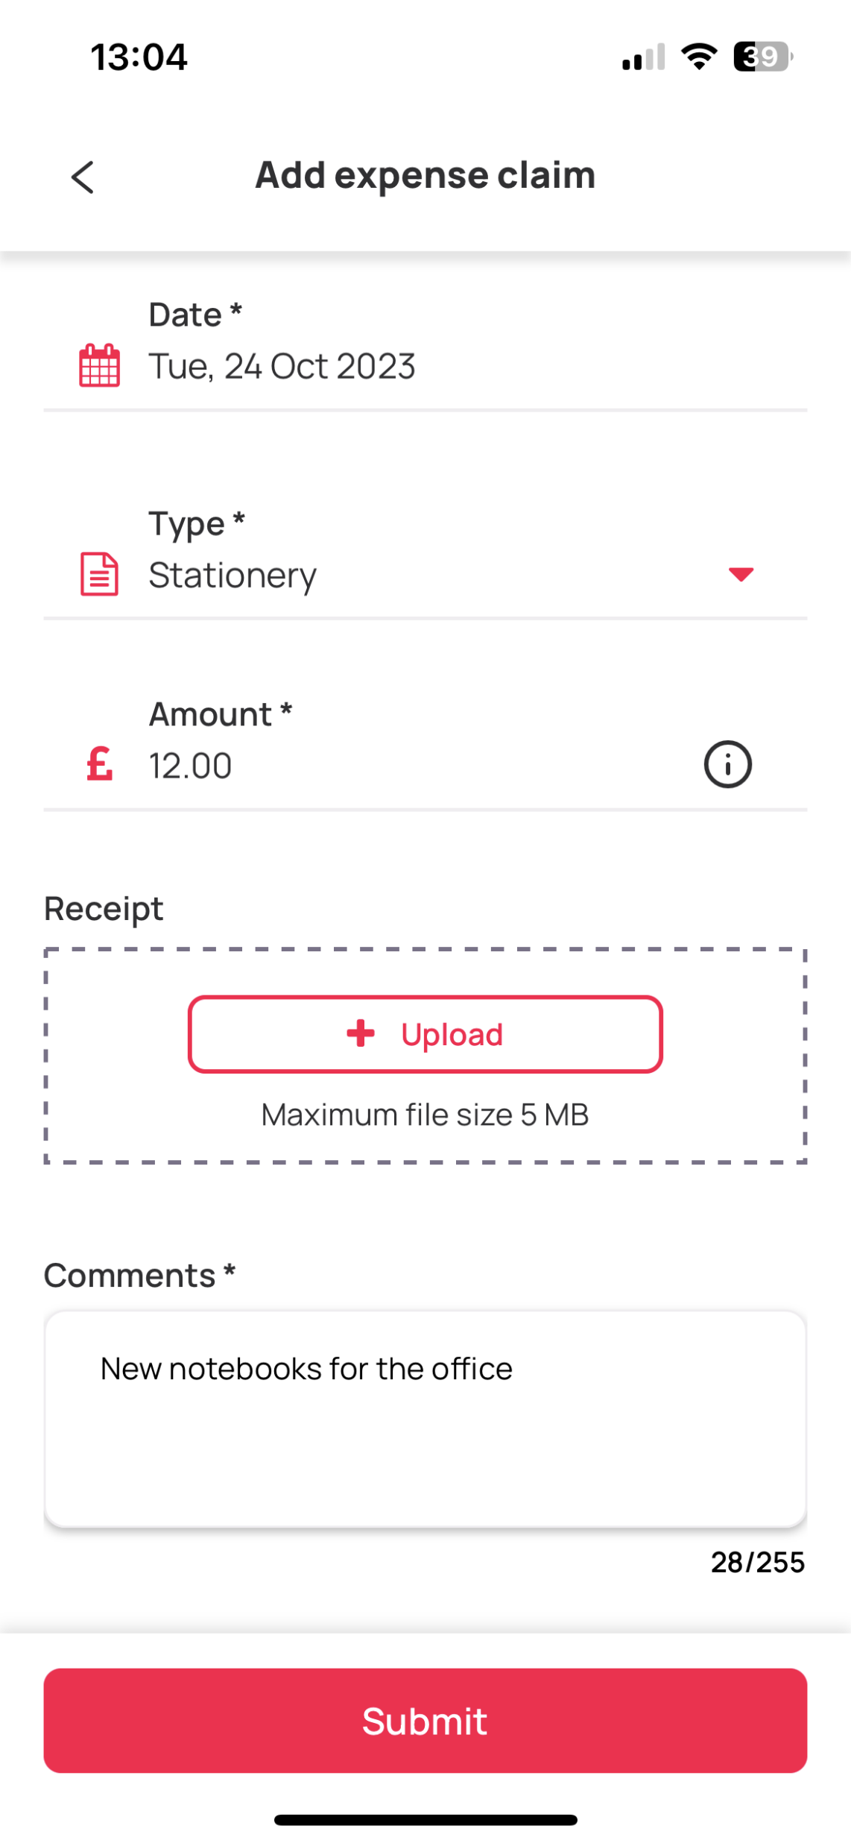

Expenses (People+)
Types of expenses
Anything your staff need to expense can be created in Personnel > Reference Settings > Others > Expense Type
How to submit an expense claim
Staff can submit claims – with receipts – in both the Staff Hub & Mobile App
Reviewing submitted claims
Managers can review claims, approve, dispute & decline claims in Self Service > Expenses and Mileage

Slide 4
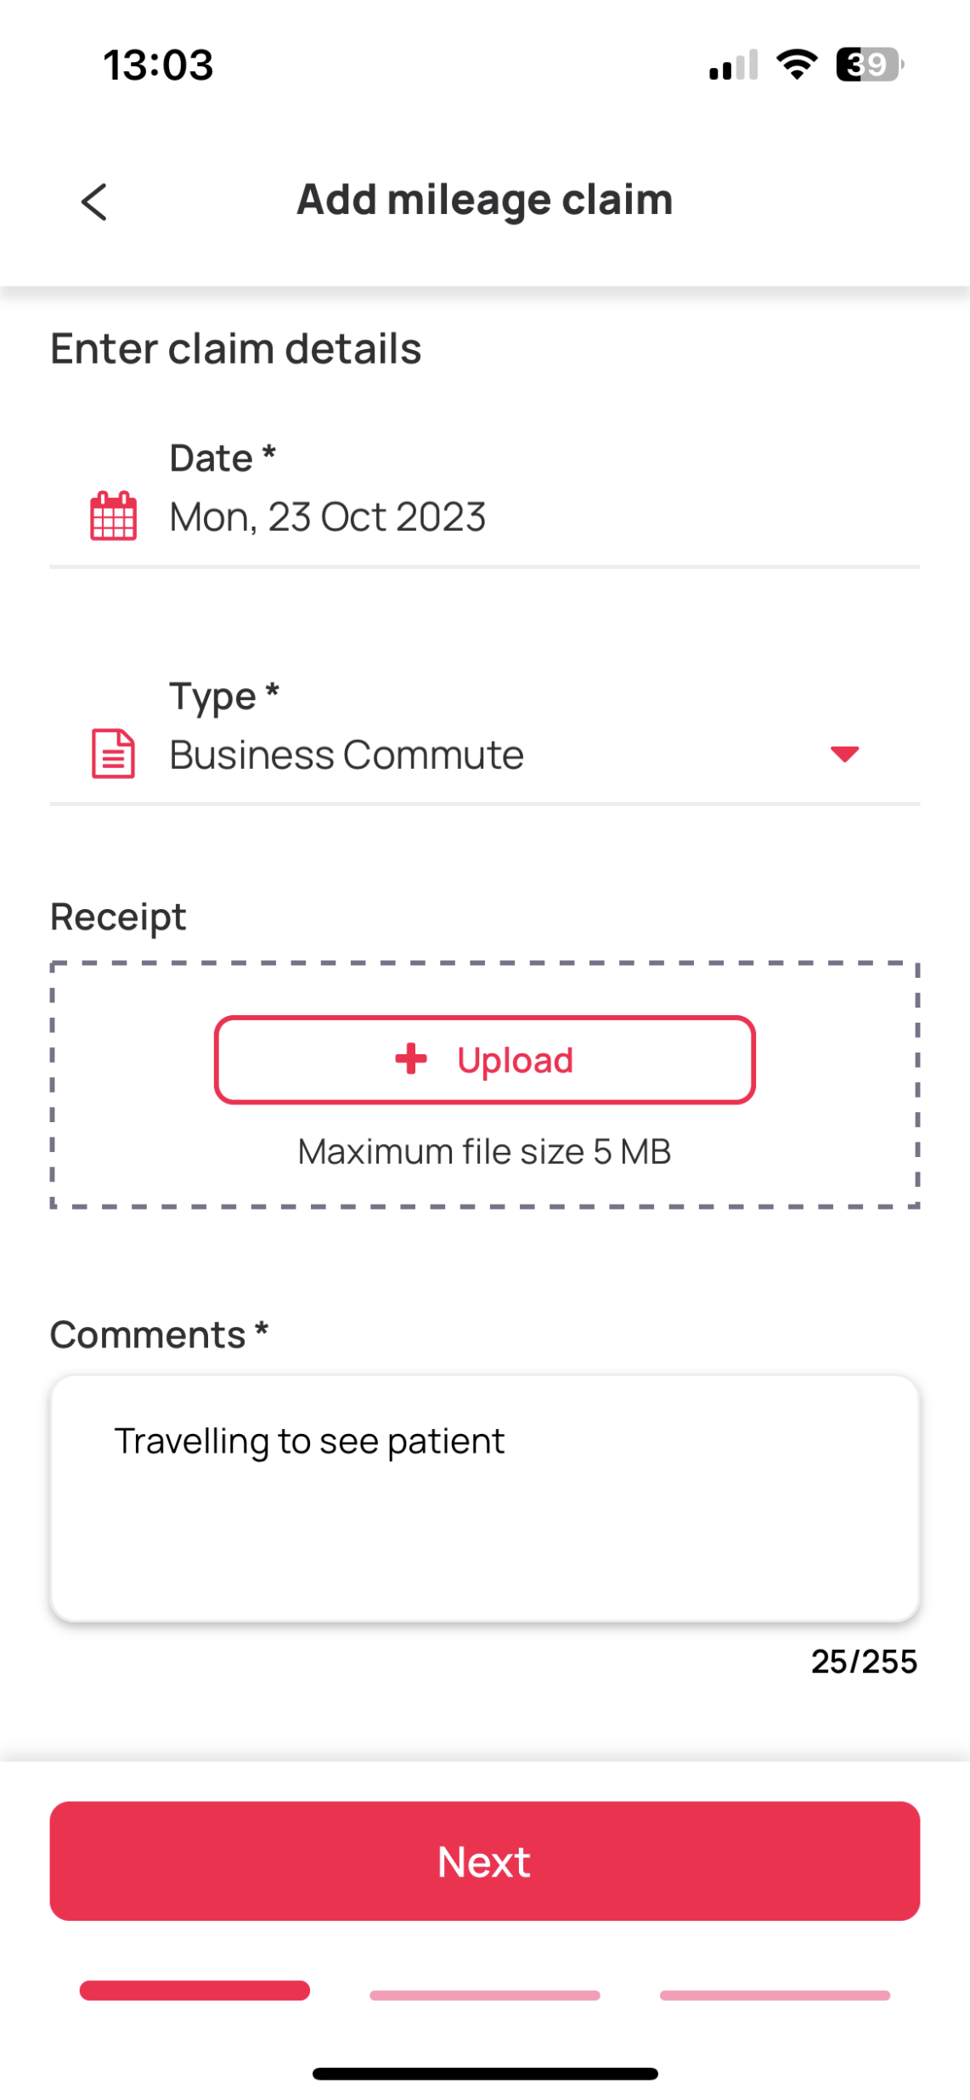

Mileage (People+)
Configuring mileage rates
Passenger/Luggage rates; thresholds & engine sizes can all be configured in Personnel > Reference Settings > Others > Mileage Type
How to submit a mileage claim
Staff can submit claims – with receipts – in both the Staff Hub & Mobile App
Reviewing submitted claims
Managers can review claims, approve, dispute & decline claims in Self Service > Expenses and Mileage

Slide 5

Notifications
What can notifications automate for my organisation?
Fully customisable, set-up your notifications & let RotaMaster send emails about important deadlines & actions, such as: staff with DBS’s due to expire soon; when someones contract is amended or a reminder that a return-to-work interview is due.
How to I set-up notifications and who receives them?
Simply navigate to Notifications > Notification Manager, select the type of notification from the drop-down menu & click the + plus button
Notifications can be configured differently for each Rota Group & depending on the type may have additional settings that can be set
Notifications can be sent to: a member of staff (notify user); the staff member’s line manager (notify line manager) and can be sent as an email notification and/or a notification within RotaMaster. You can also include any administrator to receive a notification.

Slide 6

New Functionality
💼 Request leave for Posts that start in the future (i125)
In People+, staff can now request annual leave against posts which start in the future.
⛔ Auto-approval of requests for archived staff (i125)
When a staff member is archived, any outstanding requests such as leave/overtime will be automatically declined & open sickness episodes, completed.
✅ Timestamps included in Staff Hub Timesheet screen(i125)
If a shift or adjustment has been approved or disputed, you can now hover over this to see when. The date & timestamp of when adjustments were approved has also been added.

Slide 7
New Functionality
👆 Double click to add a shift(i126)
In Rota Weekly Viewer, you can now double click in a blank space to create a new shift.
📌 Record zones against adjustments(i126)
The Zone field can now be recorded against all adjustments.
📝 Improved Audit (i126)
Interactions such as verification and approval have been recorded in the audit of adjustments.

Slide 8

Thank you

